Slide 1
JavaScript - UFO hunter game Shooting

Slide 2



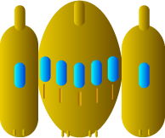
Spaceship correct positioning
0
Y
Y
X
X

Slide 3

Correct positioning of the bullet
0
Bullet starting position
Y
X

Slide 4
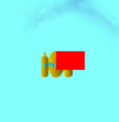
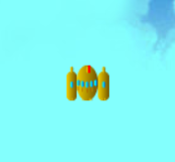
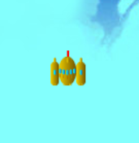
30
2
2
bullet.x, bullet.y
bullet.x-1, bullet.y-6
bullet.x, bullet.y
20
6
6
bullet.x, bullet.y

